Slide 1
April, Dig Safe Month in Saskatchewan has now concluded. The Annual Saskatchewan Common Ground Alliance Contractor Safety Breakfasts and Presentations were successfully presented in 28 locations across the province. Thank you to the contributors to the Annual Breakfast:

Slide 2
The total number of online responses were 1024 which generated 4159 RSVPs to attend the breakfasts
3,523 attended or 85% of the RSVPs attended
Information Cards were distributed – to request additional email info@scga.ca or download and print from the SCGA website: http://scga.ca/?page_id=693)
SCGA Rules around Safe Excavation & Emergency Plan Video has been put into four shortened videos. These are now available on the SCGA YouTube channel:
The 5 steps to safer digging- https://www.youtube.com/watch?v=UeY15svXOuk&feature=youtu.be
Saskatchewan OH&S Rules and what you need to know https://youtu.be/iYRmV08rsp0
Your emergency response plan https://youtu.be/H83pqJmIy5U
Staying safe with Proline Construction https://youtu.be/bd2MeF1ez_U

Slide 3
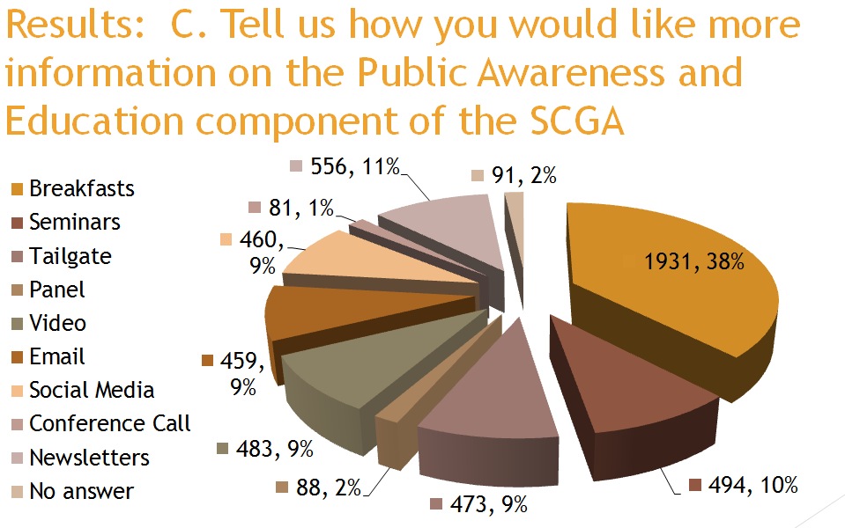
Survey results 90% of attendees still agree that there is value in the annual breakfasts:

Slide 4
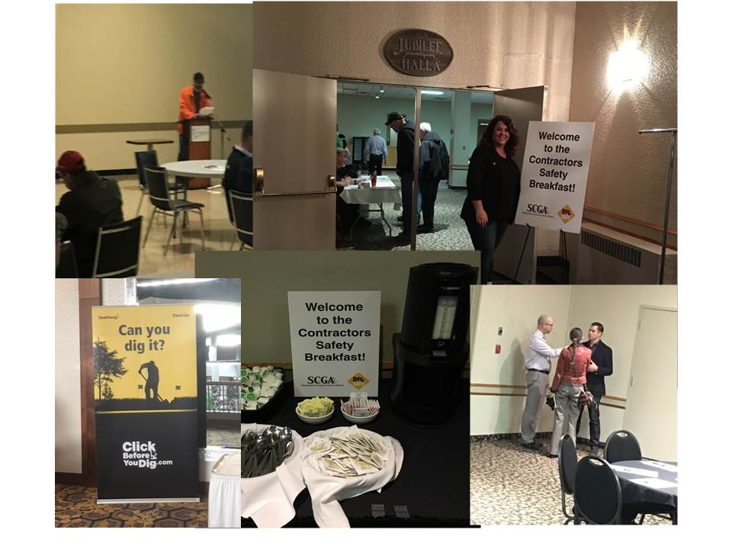

Slide 5
Media continues to be supportive of these events, thirteen news articles and two radio interviews occurred – total estimated reach through readership alone 113,264
Here are some of the stories:
Kelly Running / Carlyle Observer
April 15, 2017 01:26 AM
The Saskatchewan Common Ground Alliance (SCGA) hosted its annual Safety Breakfast in Carlyle on Tuesday, April 4, in the morning at Carlyle Memorial Hall.
Attending the breakfast were construction workers, supervisors, business owners, rural municipalities, emergency responders, and anyone associated with any aspect of ground disturbance or working near overhead lines.
The Carlyle breakfast was one of 28 sessions held throughout the province and works to reduce accidental line hits throughout Saskatchewan promoting both phrases: “Click Before You Dig” and “Look Up and Live.”

Slide 6
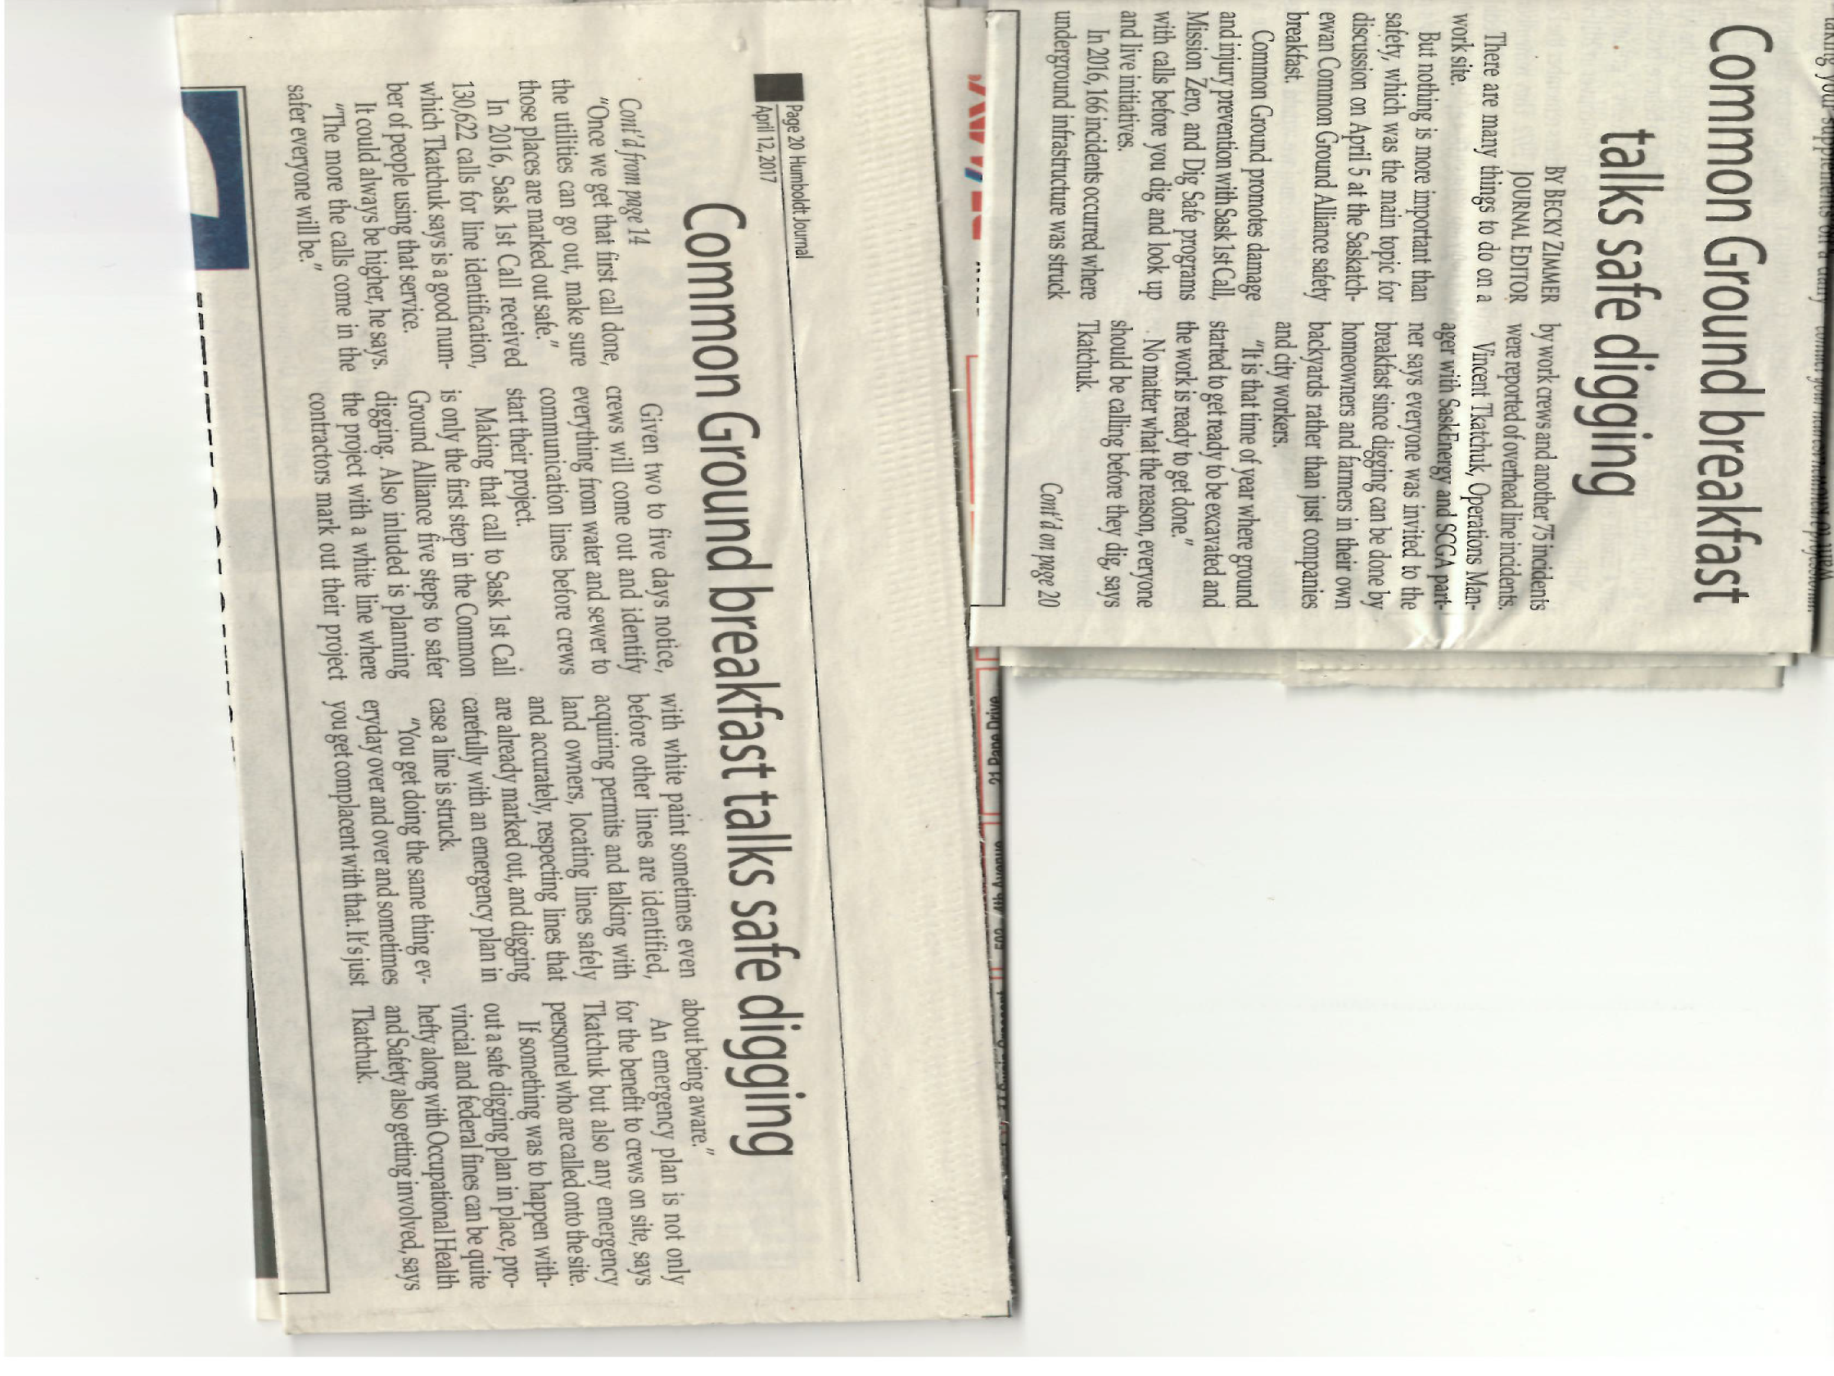

Slide 7
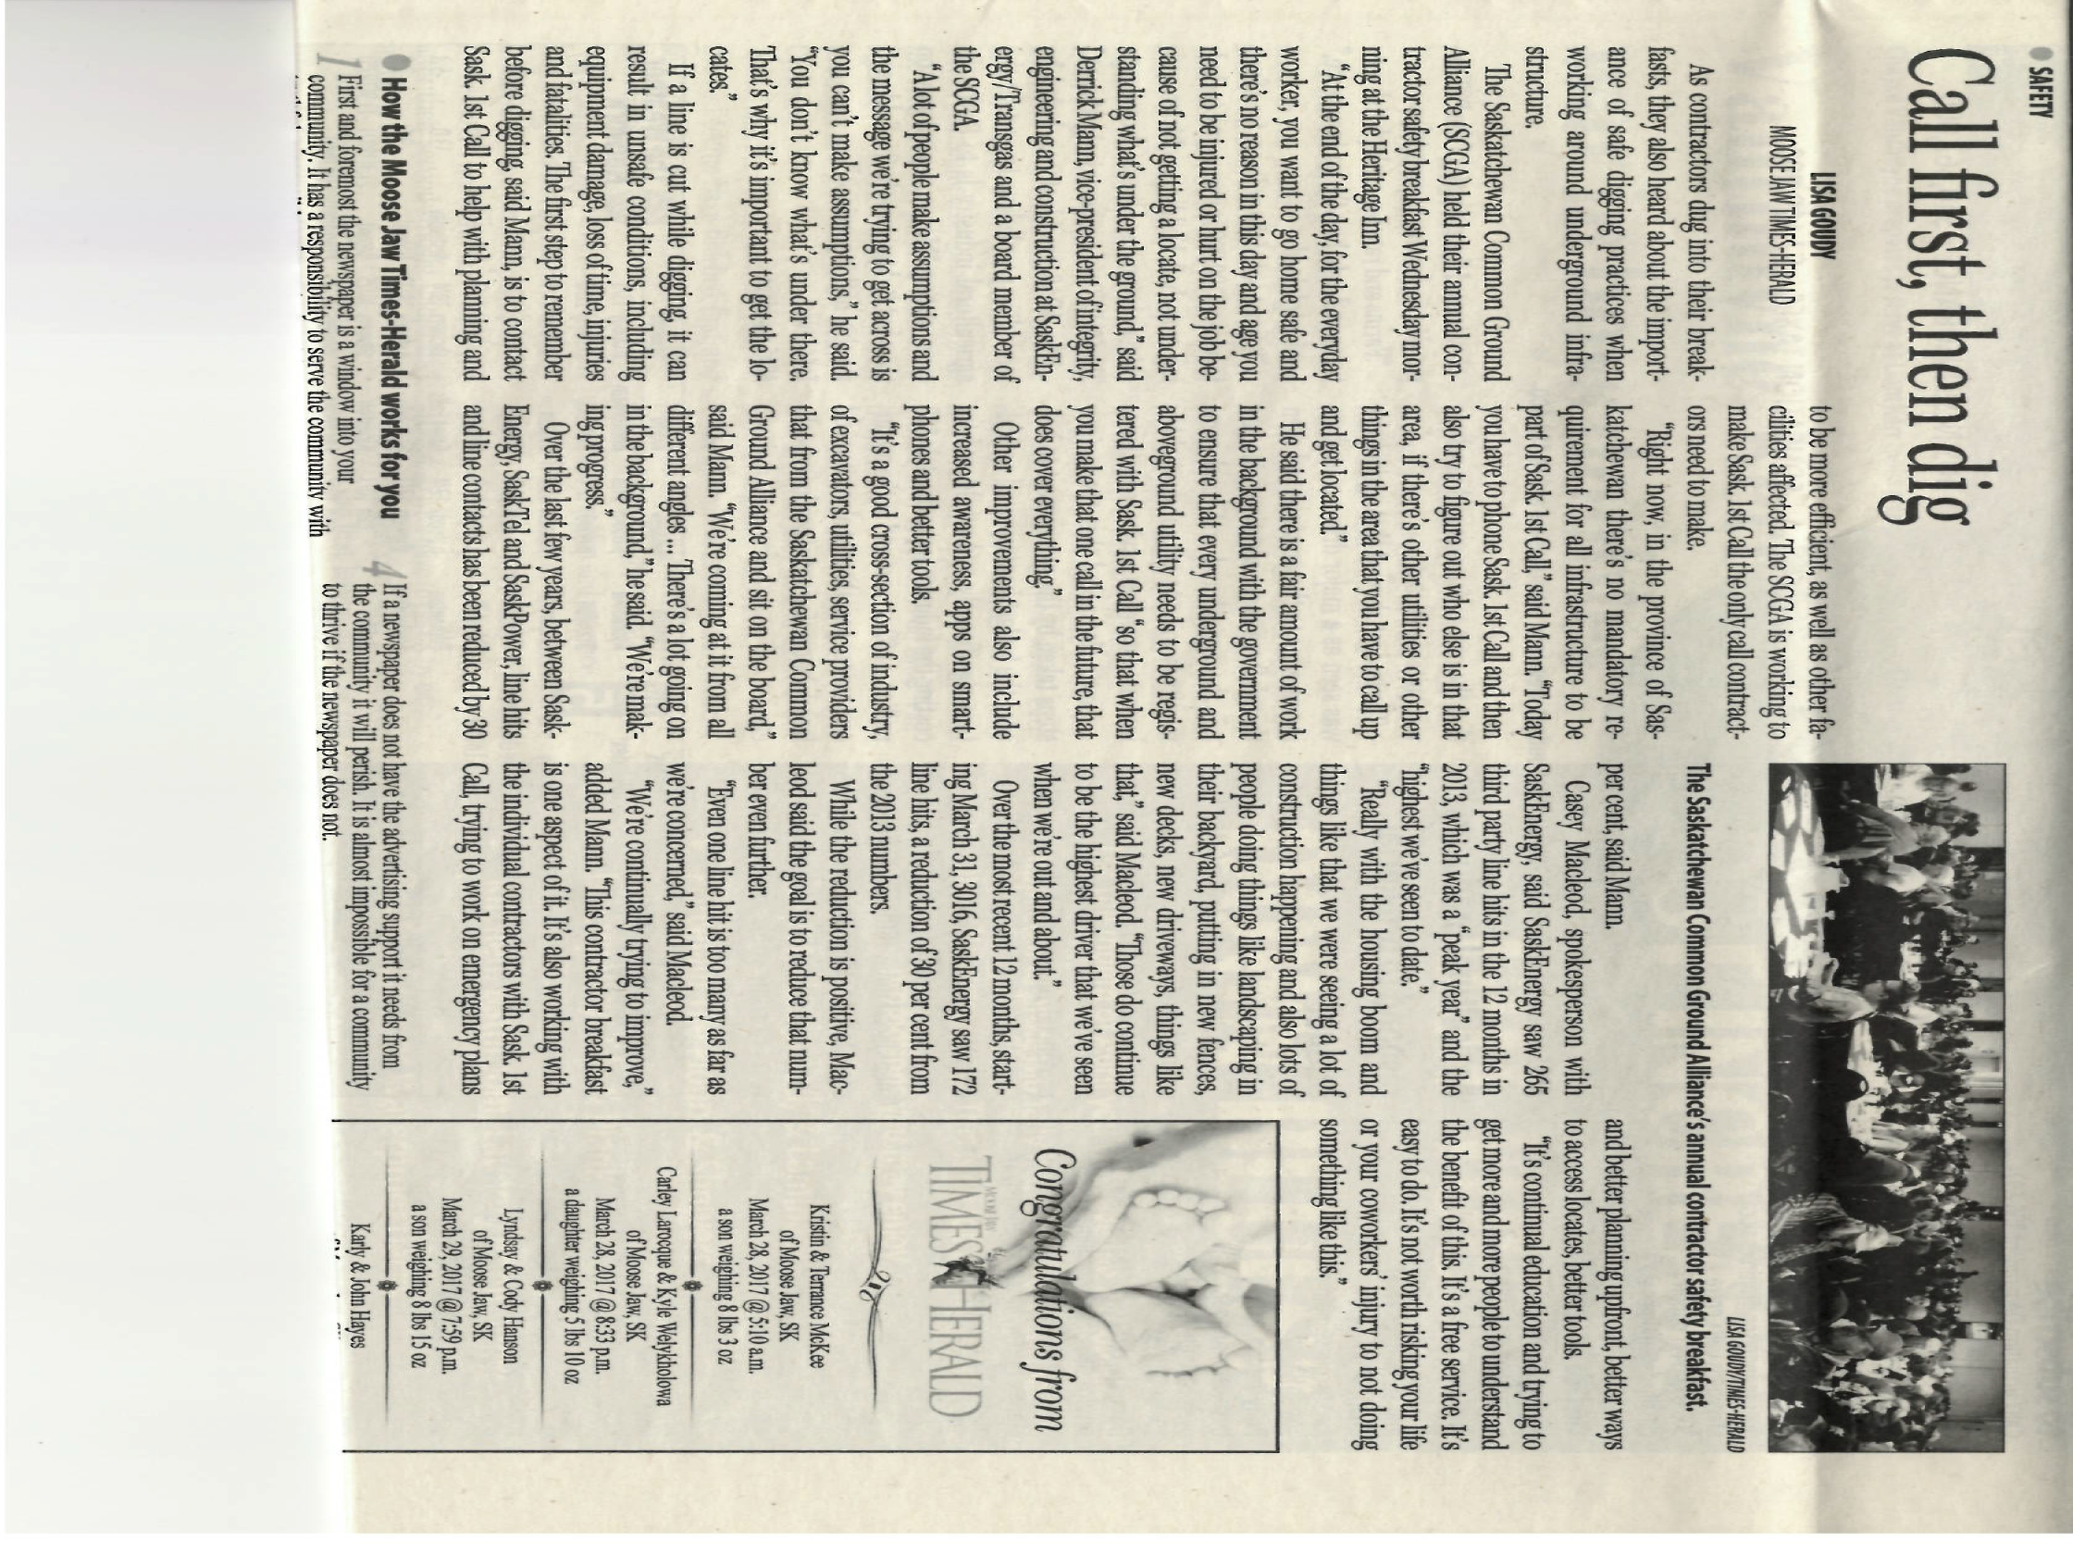

Slide 8
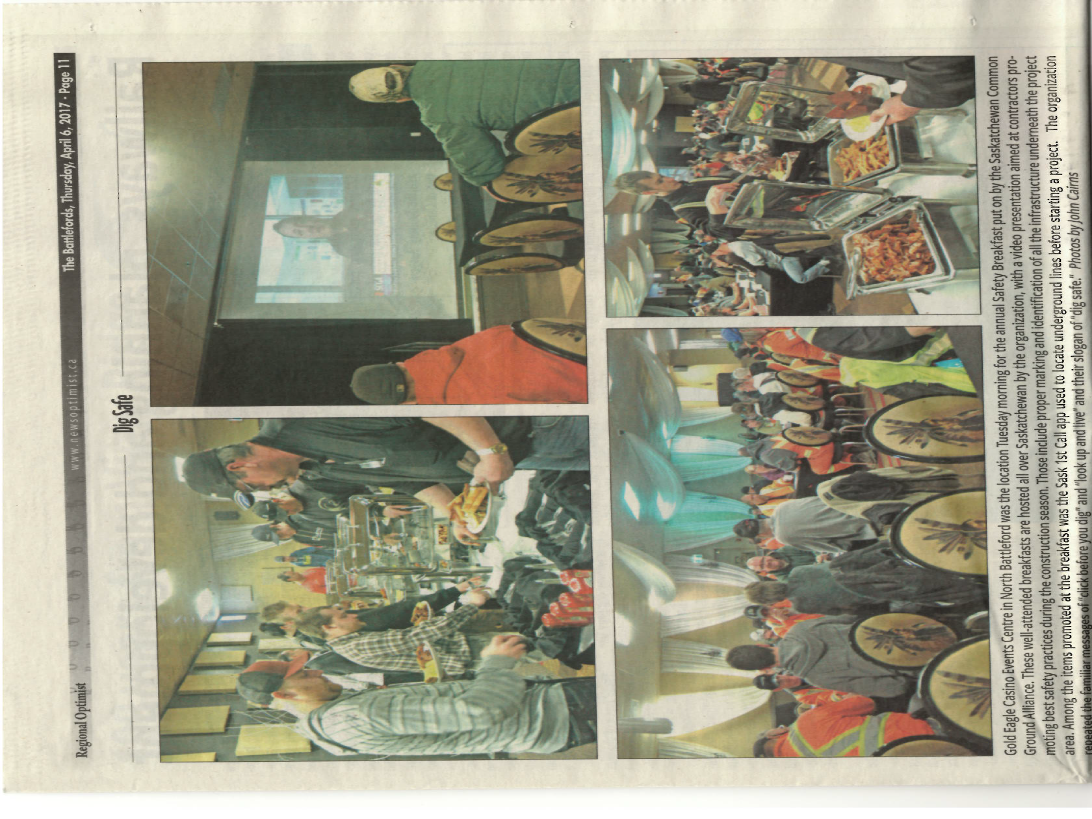

Slide 9
Local Contractors Given "First Call" Message
Wednesday
_ Category: Local News
_ Published: Wednesday, 05 April 2017 16:12
Written by Craig Hemingway
A simple message was conveyed to local contractors Wednesday morning in Moose Jaw.
"You want to go home safe," said Derrick Mann.
Mann is V-P of Engineering, Integrity and Construction with SaskEnergy, and is also on the board of the Saskatchewan Common Ground Alliance (SCGA).
The SCGA held their annual Contractor's Breakfast at the Heritage Inn Wednesday as part of Construction Week in the province.

